Slide 1
Black holes

Slide 2
CONTENT
Introduction
Perception About Black Holes
Theory Of Relativity
Gravitational Time Dilation
Space Time Fabric
How Black Holes Are Formed
Types Of Black Holes
Structure Of Black Holes

Slide 3
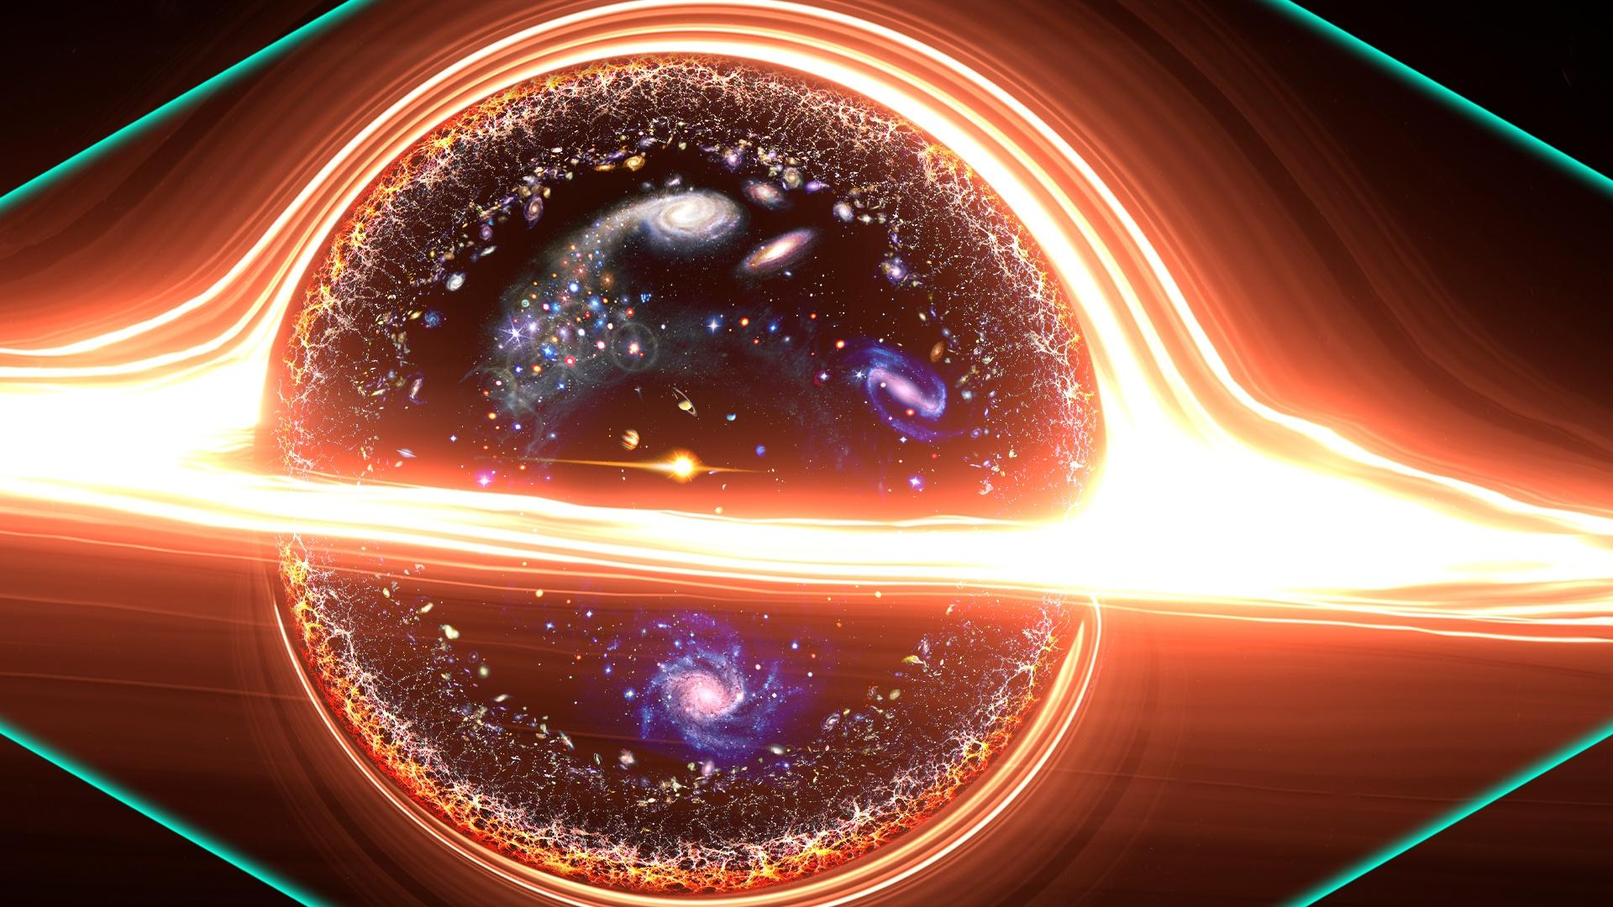
INTRODUCTION
What is Black Hole?
A black hole is a region in space with extremely strong gravitational forces that nothing, not even light, can escape from. It is formed from the gravitational collapse of a massive object, such as a star.

Slide 4
PRECEPTION ABOUT BLACK HOLES
Black holes remained largely unknown until the 20th century.
A black hole is a region in space where the force of gravity is so strong not even light can escape.
From the outside, you can't tell what is inside a black hole.
Black holes haunt our universe.
Dark centres of gravity.
That swallow everything in their path.

Slide 5
Theory of Relativity
This theory is the base for discovery of Black hole.
Because of Einstein's Theory of Relativity, black holes were later discovered.
There are two parts to the theory
The Special Theory of Relativity
The General Theory of Relativity

Slide 6
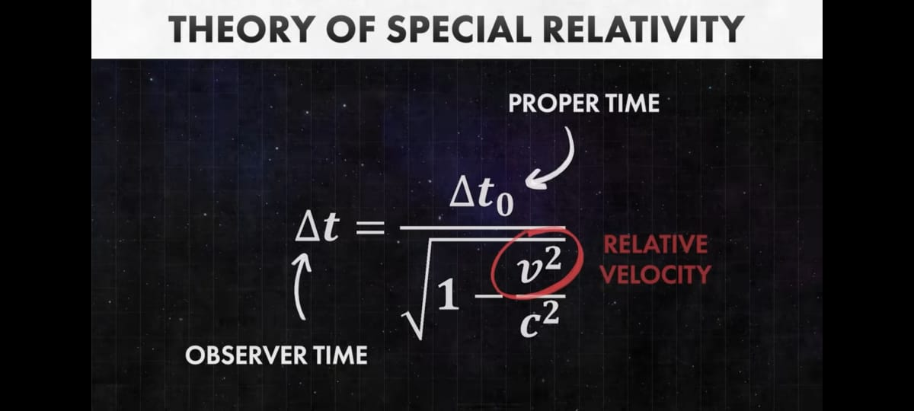
Special Theory of Relativity
The Special Theory of Relativity published by Einstein in 1905, tells us how speed influences time.

Slide 7
Theory of Relativity
If you are in a spaceship that is going very fast, if the speed is too high, time will slow down for you. Relative to the people not on the spaceship, back on Earth. The word relative is very important because when you are in a spaceship, you wouldn't feel the time slowing down. You would think that time is flowing at the same speed as it normally does. But when you'll get back to the Earth, you'll find out that there was a difference in the flow of time. This is known as Kinematic Time Dilation

Slide 8
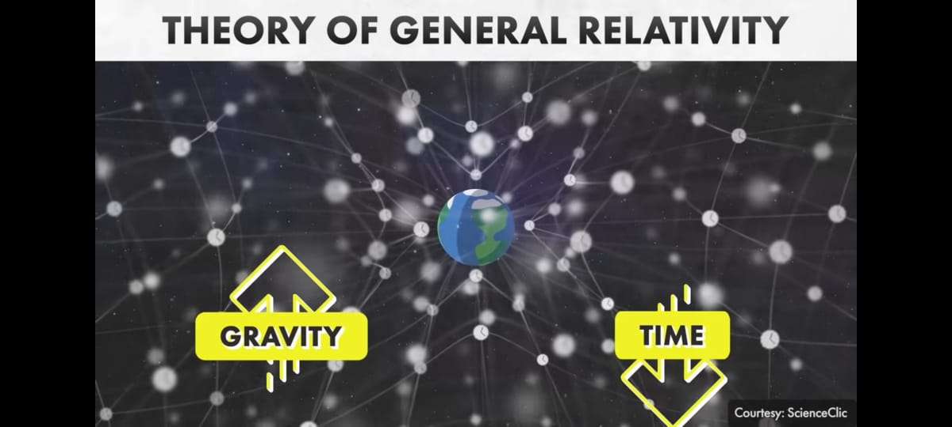
GRAVITATIONAL time dilation
Not only speed, but even gravity can also result in time dilation as shown by Einstein in his General Theory of Relativity. This was developed by him in 1915.
The more gravitational force you'd experience, the more time would slow down for you. This is known as Gravitational Time Dilation.

Slide 9
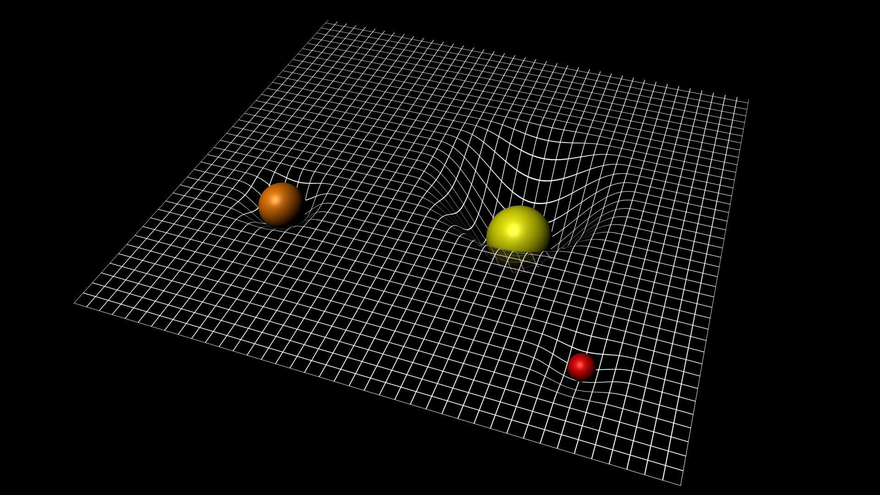
space-time fabric
Einstein wanted us to imagine a space-time fabric. Kind of like a mesh, on which all planetary objects are placed.
The space-time fabric bends due to the mass of the objects. And when the mesh bends, not only does it attract physical objects more, but it leads to time dilation as well, and the other forms of energy, such as sound, heat, or light, they are affected by gravitation as well
This was another conclusion drawn by Einstein. Gravitation affects almost everything. Not only are physical objects attracted by the force of gravitation, it attracts heat, sound, and light as well.

Slide 10
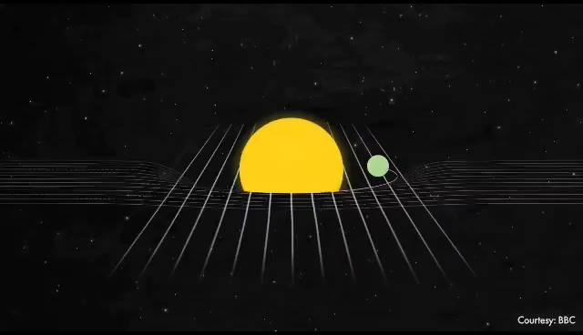
Space Time Fabric

Slide 11
EFFECTS OF GRAVITATIONAL FORCE
This means that there can be such objects in the universe which have such a high gravitational force that they can completely absorb light. If there are such objects, it means that they'd be completely black. We won't be able to see them. Because not even light can escape them. this is exactly what Black Holes are.
But when Einstein presented his Theory of General Relativity, the concept of black holes was merely theoretical back.
Einstein knew that gravitation influences light. And theoretically, objects that can absorb light were possible. But Einstein did not know that there are actual black holes.
Einstein knew that there can be such things, but then, theoretically, the existence of infinity is also possible. But realistically, he did not believe that such things existed in reality. By the time he passed away, not even the term Black Holes was invented

Slide 12
Key point of theory
a key point in Einstein's theory was that light's speed limits gravity's influence. We don't feel gravity's force instantly, everywhere
its upper limit is the speed of light. To use a practical example, suppose that the sun disappeared suddenly, as you know, we'll get to know this 8 minutes later, on Earth, about the disappearance, because it takes 8 minutes for sunlight to reach Earth.
But according to Einstein, the gravitational impact of the sun's disappearance, will also be felt 8 minutes later.

Slide 13
How Black Holes are formed?
Many researcher and scientists were drawn equations, it was theoretically proven that things like black holes, do indeed exist. The term Black Hole was used for the first time by a magazine in 1964.
But only after 1967, did the term gain popularity when physicist John Wheeler popularised it. How Black Holes are formed? This term first time is used in his lecture in \new York city in December of that year.
There's no hole in the space. Black holes are formed by stars. So there's some material at its centre. But in the stars even our Sun is a star, there's a continuous nuclear fusion reaction at their centre.

Slide 14
How Black Holes are formed?
These reactions produce heat and light. The heat being produced sends a force outwards, and at the centre of the star, there's the force of gravity, this helps the star remain intact and alive.
This is how the stars maintain equilibrium throughout their lives, the forces pushing outwards due to the reaction, and the forces pulling inwards due to gravity. But these reactions take place when a fuel exists.
Either Hydrogen or Helium. It would get burned up at some point. And when the fuel ends, there wouldn't be any forces pushing outwards. The fuel wouldn't always be there. And the gravitational force pulling inwards wouldn't be countered by an equal force, so that star will collapse on itself because of its own gravity.
This will take a long time, by the way. Our Sun's life expectancy is around 10 billion years. But what happens next depends on the mass of the star.

Slide 15
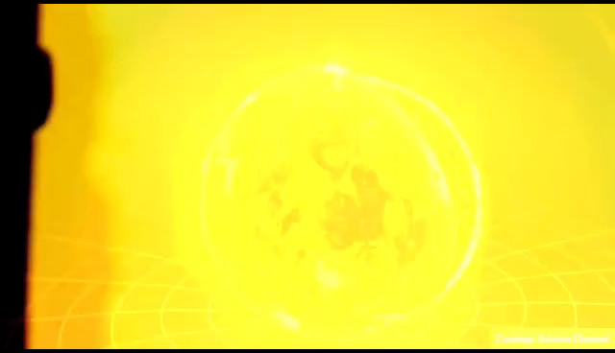
How Black Holes Are Formed?

Slide 16
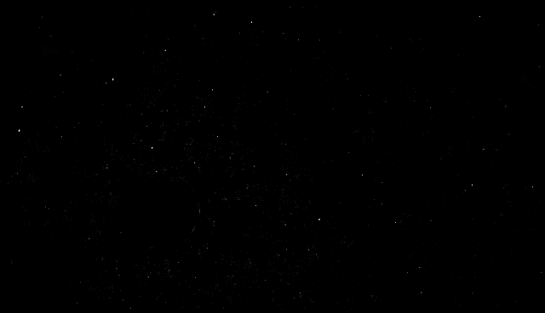
How Black Holes are formed?

Slide 17
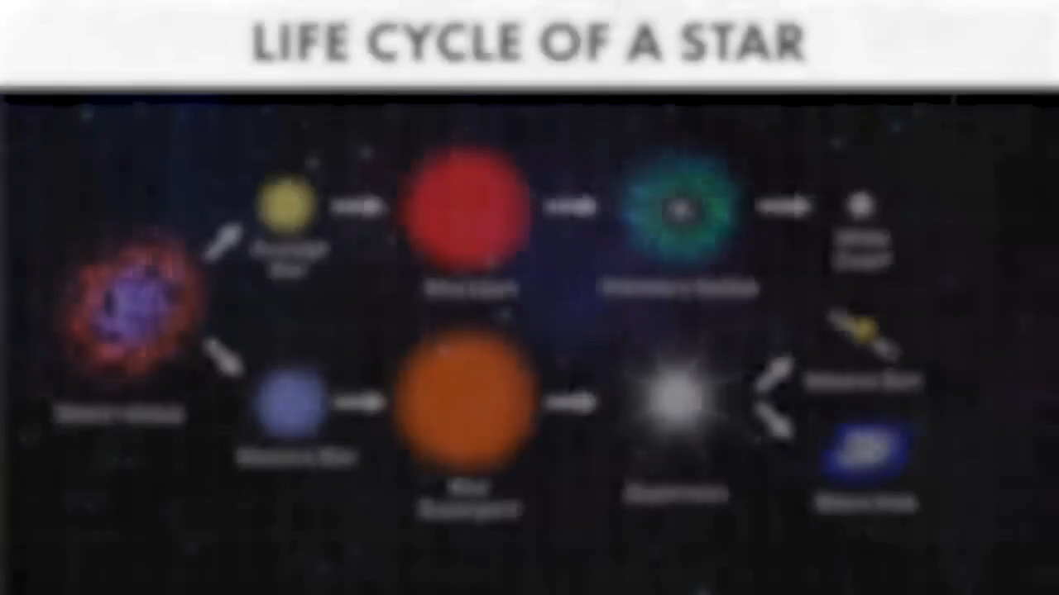
Life Cycle of a Star

Slide 18
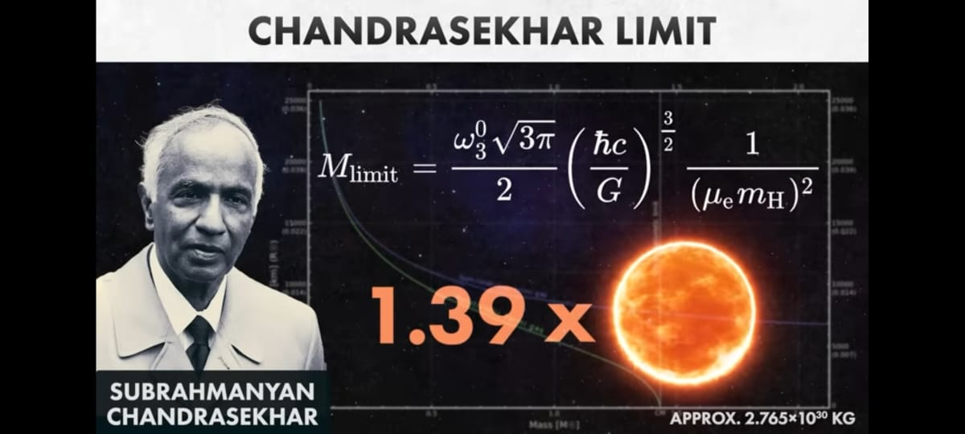
Sun turn into black hole or not?
For a star as big as our Sun, if that turns into a black hole, the diameter of that black hole will be merely 50 km.
The interesting thing here is that, our ‘sun' will not grow up to be a black hole This was proven by an Indian-American astrophysicist Subrahmanyan Chandrasekhar.
He developed the Chandrasekhar Limit value. He said that the maximum mass of a White Dwarf can be 1.4 times the mass of our Sun. Above which, it cannot be stable.
and would turn into either a Neutron Star or a Black Hole.
But since the Sun, is under this limit,
it will become a White Dwarf, instead of a Black Hole.

Slide 19
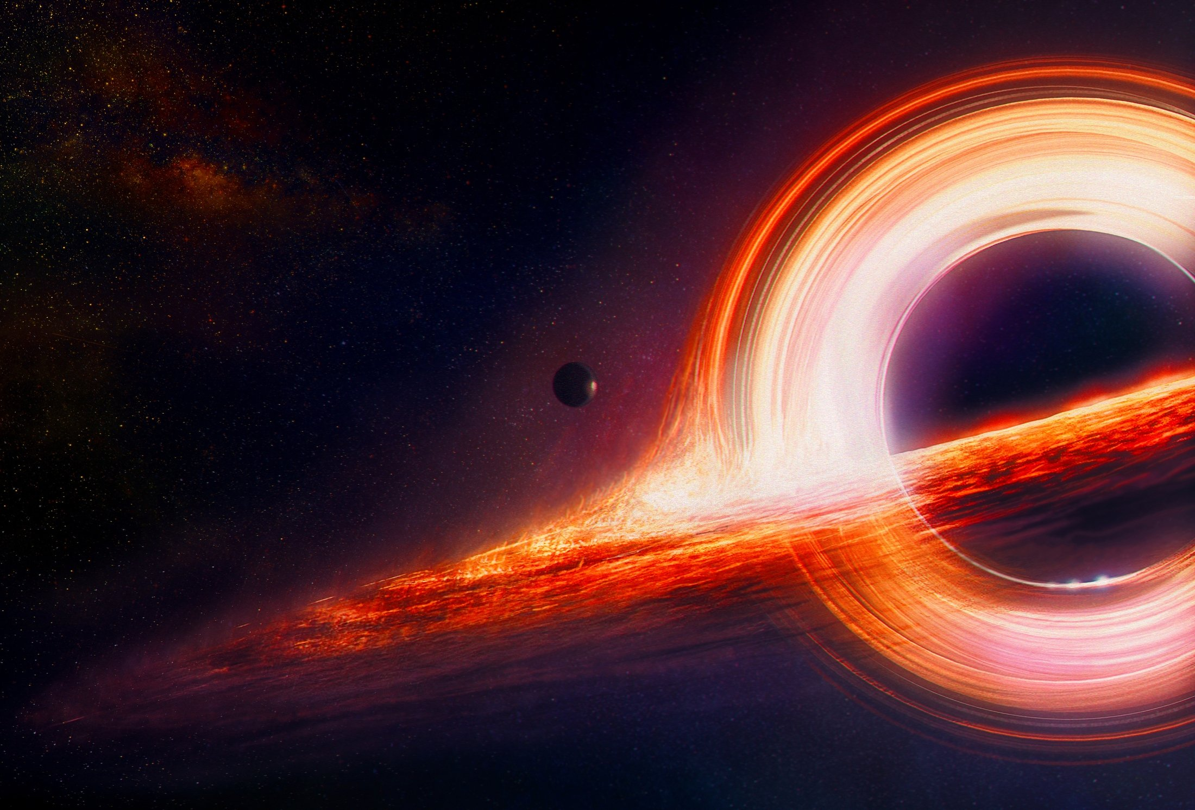
Types of black holes
Stellar Black Holes
These are formed from the gravitational collapse of massive stars. When a massive star exhausts its nuclear fuel, it undergoes a supernova explosion, leaving behind a core that collapses under its own gravity to form a stellar black hole. Stellar black holes typically have a mass several times greater than that of the Sun.
Scientists estimate that in our Milky Way Galaxy, there are anywhere between 10 million to 1 billion such black holes.

Slide 20
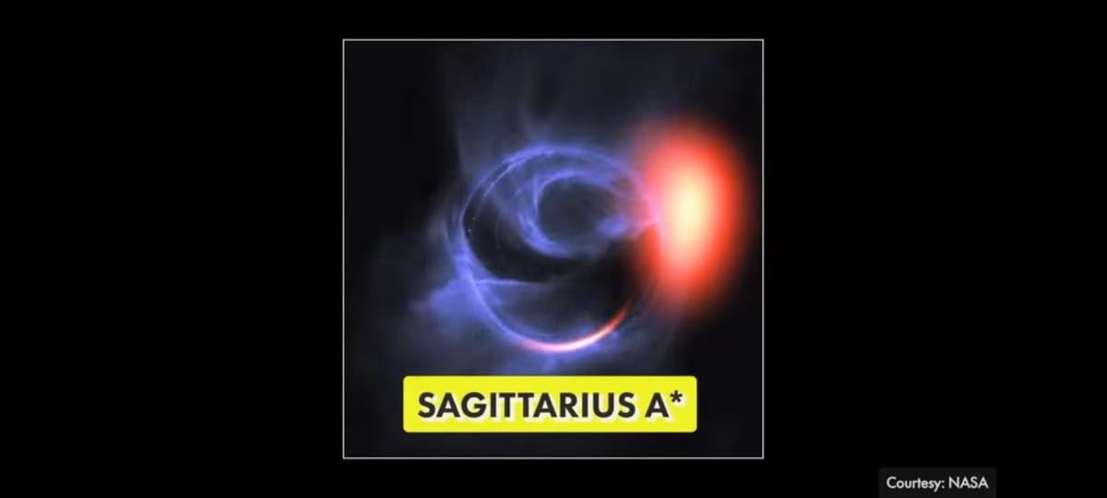
Types of black holes
2. Supermassive Black Holes:
These black holes are enormous. So big that their mass is more than that of 1 million Suns combined. And it fits into a ball whose diameter is as big as that of our Solar System. Scientists believe that at the centre of every major galaxy, there is a Supermassive Black Hole. The Supermassive Black Hole at the centre of our Milky Way Galaxy, is called Sagittarius A.=ss.ss

Slide 21
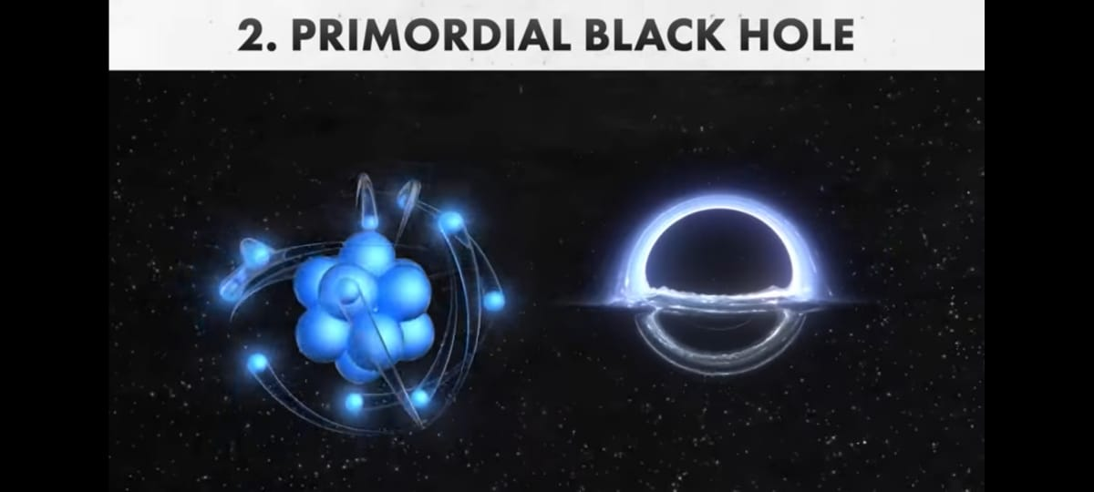
Types of black holes
3. Primordial Black Holes
These are hypothetical black holes that could have formed in the early universe shortly after the Big Bang.
There are the Primordial Black Holes. These black holes are as small as an atom.
But their mass, is like that of a mountain. It is an assumption that they are as small as an atom.

Slide 22
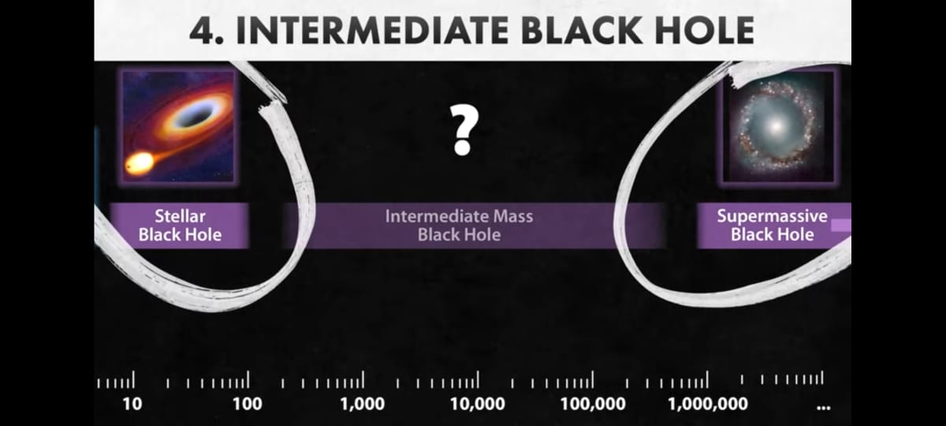
Types of black holes
4.Intermediate Black Hole:
The fourth type of black hole will be Intermediate Black Hole That lies somewhere between the sizes of Stellar and Supermassive black holes. Although, no proof of it has been discovered yet.

Slide 23
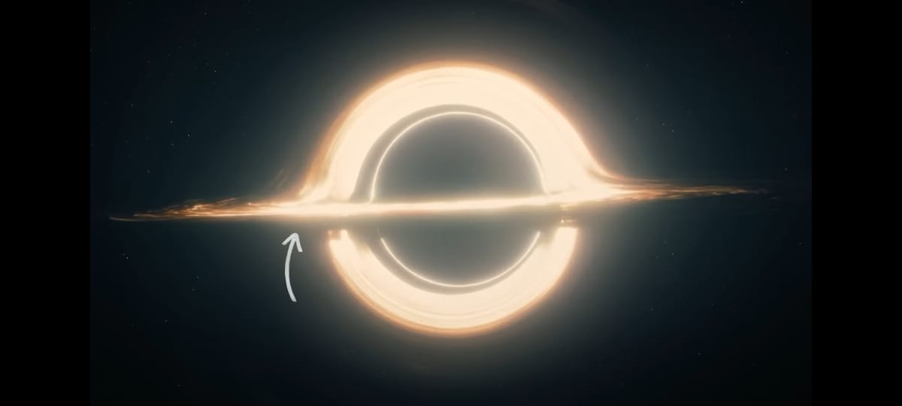
Accretion Disk
The black hole isn't like a big black ball that sucks everything around it.
The first thing that you'd notice in this photo, is the orange-coloured ring, that forms around the black hole. It is known as the Accretion Disk.

Slide 24
fluid-like matter
. The gravitational pulls in black holes is very high, So due to the gravitational pull, a lot of gaseous matter and debris is attracted towards the black hole, and remains floating all around it. Similar to how the planets revolve around the Sun, because of the Sun's gravitational force.
The difference is that the gravitational pull of black holes is so strong, that the things revolving around it, revolves at a very high speed, and gets so heated up that they turn into a flowing fluid-like matter.
They literally become fire-like particles, that are hotter than a million degrees Celsius.
The closer they get to the black hole, the faster they revolve around it. The particles revolve so fast, that they get rubbed together and compressed this causes them to start glowing

Slide 25
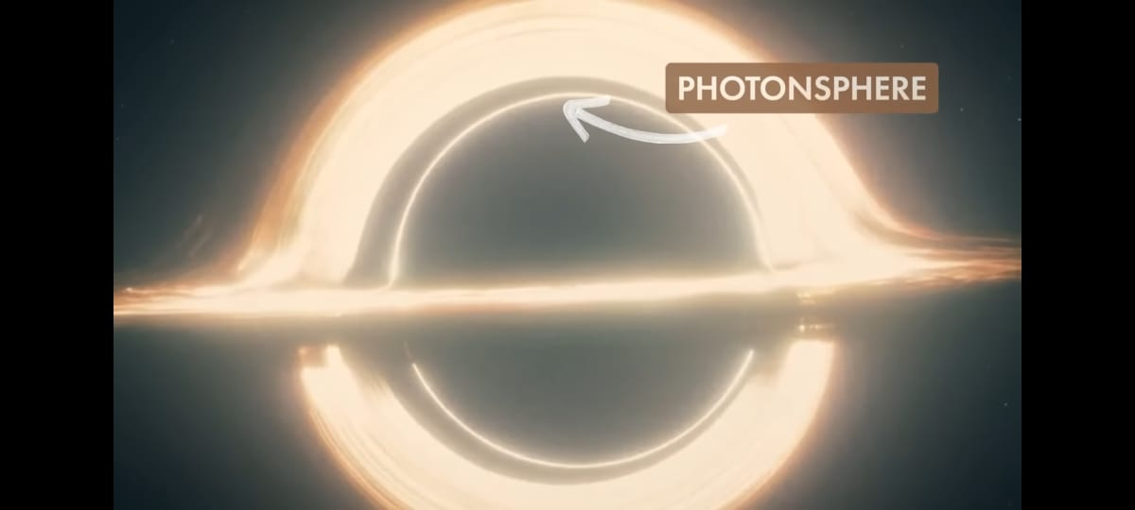
Photon sphere
A last circle of light is the Photon sphere. The gravity in this area is so strong that the light starts orbiting the black hole. Light is made of Photons. The Photons start orbiting the black hole.
This means that if you reach this area of a black hole alive, it is theoretically possible to see the back of your head since the light is travelling in a circle, in the formation of a ring.

Slide 26
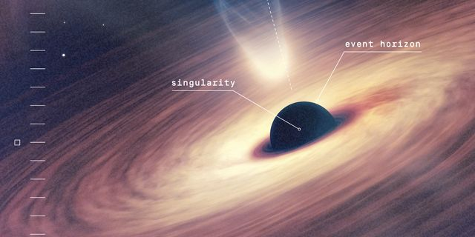
Event Horizon
After this point, is the boundary of the black hole. This is known as the Event Horizon. It is considered a boundary because after this point, the gravity is so strong that even the light cannot escape.
Everything is black beyond this point. If you are falling into a black hole, and you have crossed the event horizon, theoretically, there's no chance of you escaping. If not even light can escape it.
It is speculation because we do not know what is inside the Event Horizon

Slide 27
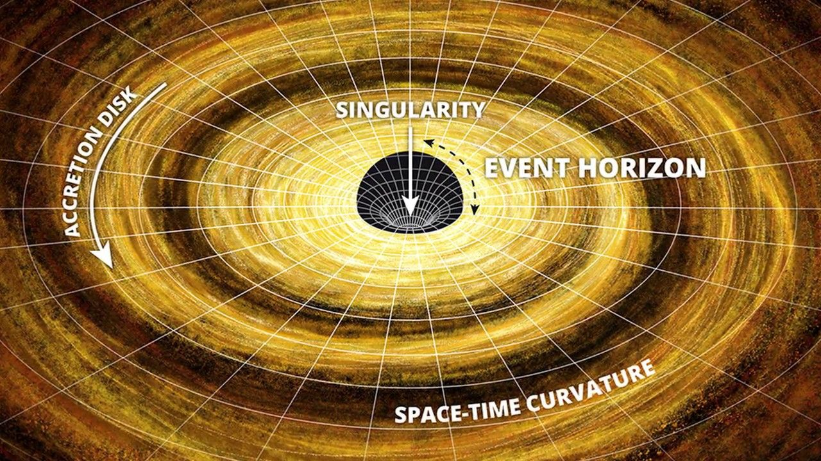
Singularity
What will be at the centre of the black hole? Einstein's General Theory of Relativity tries to describe this. In this theory, the centre of the black hole is termed Singularity.
Singularity is the region of a black hole, the centre where the curvature of space-time is infinite.
The heavier the object, the more the mesh of space-time will bend. In the case of a black hole, This is bent so much that it stretches infinitely. As we know from the theory of relativity, time, energy, and everything else is affected by gravity, With the increase in the gravitational force, time keeps getting slower infinitely.
But what does it mean for time to get slower infinitely? Does this mean that if you go inside a black hole and if you ever could get out of it, the universe outside would have ended for the rest of us?
We do not know.
We can only make theories

Slide 28
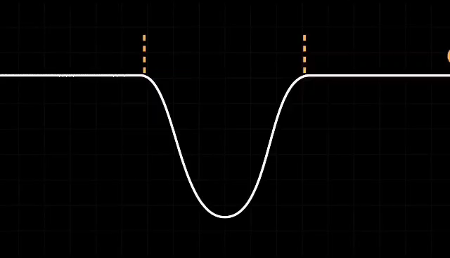
WORMHOLE

Slide 29
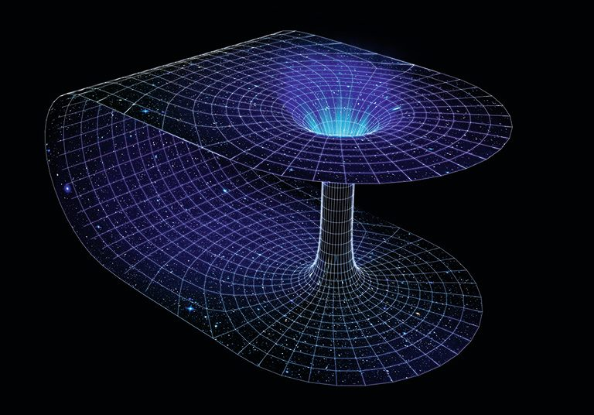
Wormhole

Slide 30


